Slide 1
Intranet

Slide 2
Intranet
An intranet is a private network contained within an enterprise that is used to securely share company information and computing resources among employees
A company-wide intranet can constitute an important focal point of internal communication and collaboration, and provide a single starting point to access internal and external resources.
In its simplest form, an intranet is established with the technologies for local area networks (LANs) and wide area networks (WANs)

Slide 3
Intranets
Network within an organization that uses Internet protocols and technologies for:
  Collecting, storing, and disseminating useful information that supports business activities
Otherwise known as corporate portals
Facilitates internal use by employees
  Companies also allow trusted business partners to access their intranets

Slide 4
Intranets
Uses Internet technologies to solve organizational problems
Different from an LAN
Defining and limiting access is important for security reasons

Slide 5
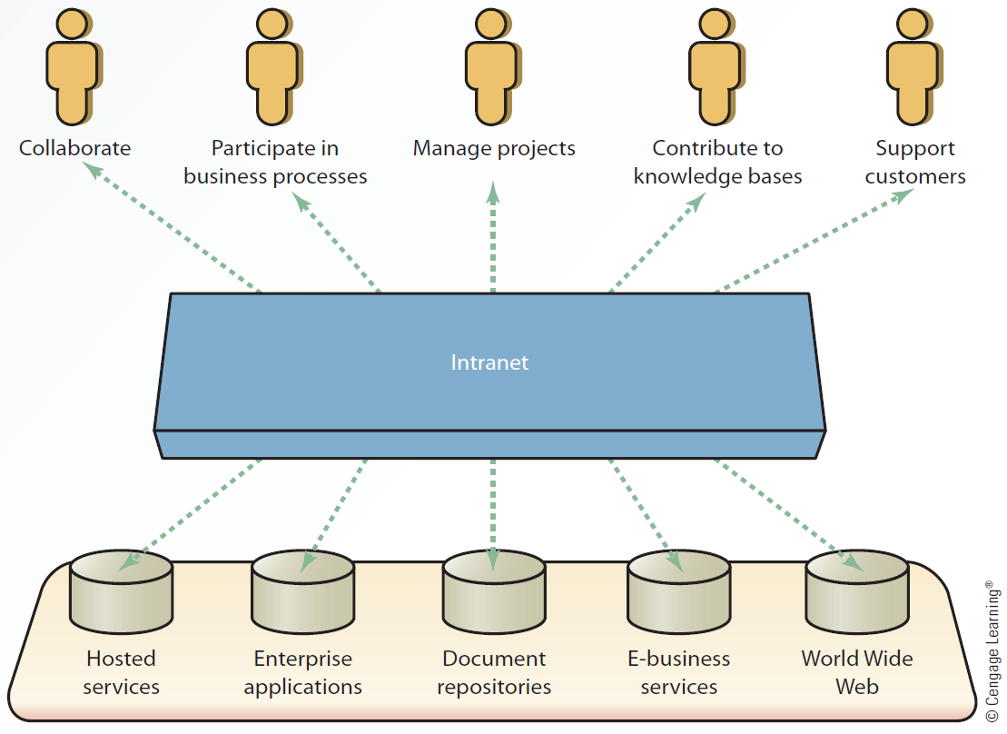
7.3 Simple Intranet Architecture

Slide 6
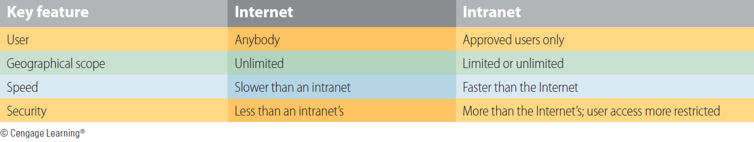
7.2 The Internet versus Intranets

Slide 7
Business Applications of an Intranet
Human resources management
Sales and marketing
Production and operations
Accounting and finance
Helps organizations move from a calendar-based, document-publishing strategy to an event based strategy
Reduces the costs and time of document production

Slide 8
Uses and Benefits
Accessing information: with a content management system (CMS) and frequently integrated with an organization’s document management system (DMS), intranets can be used to centrally host and access documents, policies, and information employees require to perform their roles.
Connecting people: globalized organizations and those with employees working remotely, on the frontline or across a range of office locations face challenges connecting their staff. An intranet helps colleagues find one another, connect, and communicate: building a virtual culture.

Slide 9
Uses and Benefits
Knowledge management: alongside formal information and documents, organizations typically hold vast levels of knowledge amongst their employees.
Completing tasks or workflows: combining forms or transactional applications with hosted information, intranets enable employees to self-serve and complete common processes
Internal communications: through social and communication tools such as blogs, wikis, forums, and discussions, an intranet can be used to facilitate effective two-way internal communications between management and staff.

Slide 10
Uses and Benefits
Measuring and improving employee engagement: it’s known to have a critical impact on business performance, yet presents one of the greatest challenges for business leaders.
Supporting strategic business objectives: intranets can play an active role in support high-level business objectives
Time: Intranets allow organizations to distribute information to employees on an as-needed basis;
Cost-effectiveness: Users can view information and data via web-browser rather than maintaining physical documents such as procedure manuals, internal phone list and requisition forms

Slide 11
Extranets
Secure network that:
  Uses the Internet and Web technologies to connect intranets of business partners
  Facilitates communication between organizations or between consumers
Considered to be a type of inter-organizational system (IOS)
  Electronic funds transfer (EFT)
  Electronic data interchange (EDI)

Slide 12
Extranets
Allow companies to reduce internetworking costs and give competitive advantage
  Leads to increased profits
Require a comprehensive security system and management control

Slide 13
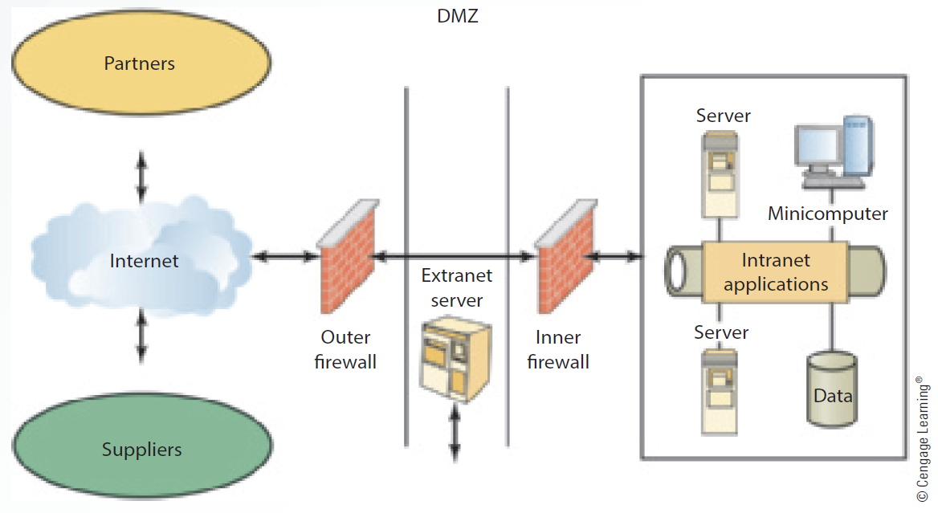
7.4 Simple Extranet Architecture

Slide 14
Advantages of Extranets
Coordination
Feedback
Consumer satisfaction
Cost reduction
Expedited communication

Slide 15
WorkGroup Computing

Slide 16
WorkGroup Computing
Workgroup computing refers to any computer system that replicates the manual work process.
Anytime two or more people work together sharing information on a computer system it can be defined as group computing.
It is a way to electronically process human transactions.
The focus is on information sharing, coordination and collaboration
When two people manually send letters or memos to each other, it is called a workgroup process.

Slide 17
WorkGroup Computing
When two people send the same letters or memos using e-mail, it is referred to as workgroup computing
Any software that supports workgroup computing can be labelled as groupware.
There are three different levels of group computing:
Individual level
On this level the members individually work toward a group goal but there is no group coordination
Members use word processors, spreadsheets and databases, but do not coordinate their efforts

Slide 18
WorkGroup Computing
Here, we find duplication and lack of sharing of work that oftentimes produces inconsistent results
Coordinated effort
On this level, the members coordinate and actively manage the flow of work by structuring work processes
It goes beyond individual automation and provides a structured work environment.
The structures are the processes that need to be completed for a legal function

Slide 19
WorkGroup Computing
The coordinated effort focuses on the communication in the transmitting and receiving of messages.
The basic tool for information sharing is e-mail.
There are no time and place barriers. It pushes information to others
Other tools that support these coordinated efforts are schedulers, project managers, shared databases, and workflow automation software.
This may require some development or customization of commercial software packages.

Slide 20
WorkGroup Computing
Collaborating
Members here make concerted efforts for information sharing, discussions, and obtaining other information as needed
It pulls information from many different data storage areas for use by all the team members
It is a “virtual” workplace that allows collaborative information exchanges without the constraints of time and space
Shared whiteboards, electronic brainstorming, shared editors, electronic conferencing, and electronic voting are technology tools that are supportive of this group dynamic.

Slide 21
WorkGroup Computing
There are several different types of group computing
Teleconferencing is a meeting among people in different geographical locations using the telephone.
Computer teleconferencing is a keyboard conference among several users at computers linked through a network or the Internet.
Document conferencing participants not only see and hear each other, but work on text and graphic projects at the same time.
Application sharing is allowing all the participants to run a software program that is located on one user’s machine
Videoconferencing is where two or more people are sharing video of each other or others

Slide 22
Electronic Data Exchange(EDI)

Slide 23
Overview of EDI
Electronic Data Interchange (EDI) is the computer-to-computer movement of routine business data in an approved standard format (e.g., ANSI ASC X12, EDIFACT or TRADACOMS)
Companies that decide to trade business data with each other using EDI are called trading partners
The trading partners must decide which transaction sets (EDI business documents) will be exchanged electronically,
what information will be included (i.e., what segments and data elements within the transaction set should be sent and received),
and what method of communications will be used (e.g. asynchronous
communications via a Value Added Network or bisynchronous direct communications)

Slide 24
The EDI Standard data format can be thought of as a common language that allows all companies to communicate with each other
DiTranslator translates the data coming into and going out of your PC, so you and your trading partner will be able understand each other's data.
An example of an EDI exchange could involve a buyer and a seller.
Suppose the buyer identified an inventory need.
A purchase order is produced by manual data entry or from data within the buyer's business application.

Slide 25
DiTranslator will take this data and translate it into EDI standard format.
The EDI data then passes through communications software that routes it over an electronic communications link to the seller.
When the seller receives the transmission, the data is converted into a format that can be passed to the seller's order entry system or printed using their EDI software.
Once the seller has received the data, a Functional Acknowledgment should be sent to the buyer indicating the transmission was received, and detailing any errors found when the transmission was validated against the EDI standard.
Then the seller may initiate an EDI Invoice to the buyer, and perhaps the buyer will respond by acknowledging the Invoice and paying for the items with an EDI Payment Order/Remittance Advice.

Slide 26
EDI and Data Communications
Data communications is an essential ingredient in the EDI process.
It is the conduit enabling you to exchange electronic business transactions with your trading partners.
In the EDI model, data communications is used as a subsystem to
transfer information from a source computer to a target computer.
It is important to understand that EDI and data communications are two distinct technologies.
EDI defines an encoding standard for business information.
Data communications defines mechanisms to transfer this EDI encoded information between your computer and your trading partner’s computer.

Slide 27
EDI and Data Communications
First, your customer prepares the Purchase Order data following the language rules of EDI standards. The Purchase Order data resides at a remote location.
You then launch a data communications session using DiTranslator, which connects your computer to this remote location.
During this data communications session, a file transfer mechanism is used to move the Purchase Order data, already in EDI format, from the remote computer to your computer.
The data communications session is then terminated.

Slide 28
EDI and Data Communications
You are then able to process the Purchase Order data using DiTranslator.
You may need to send an Invoice to your trading partner. In this case, you prepare the Invoice using DiTranslator.
You then launch a communications session, which connects your computer to the remote destination.
The Invoice, in EDI standard format, is moved from your computer to the remote computer during this communications session.

Slide 29
EDI and Data Communications
Occasionally, EDI standards define guidelines for data communications used in an EDI process.
These guidelines may include time constraints, which help assure that responses to transaction sets received will be sent within a specific time
period.
EDI standards also define how the sender’s address and receiver’s address are encoded.
However, EDI standards do not normally define the communications, which actually cause the data to move from source to destination.
A variety of data communications modules are supported by DiTranslator. You simply use the module required to link to the desired remote location

Slide 30
The Case of the Automobile Industry
A common trait for the automobile industry in more recent times has been “just-in-time” delivery and manufacturing.
Since cars are high cost items, excess inventory is costly, and there is a risk of producing units that will not move in showrooms, increasing the need for discounts and purchase incentives.
As a result, automobile manufacturers have increasingly pushed the inventory risk of raw material and sub-assemblies over to their suppliers
Resulting in a massive focus on delivering materials and sub-assemblies only when needed by the manufacturers
This concept is commonly known as “just-in-time” deliveries

Slide 31
The Case of the Automobile Industry
In fact, it is fairly common for a supplier to build a new factory and warehouse close to the automobile assembly plant in order to fulfill the terms of their contracts of delivering just-in-time.
Naturally, this has also led to high demands on the information system infrastructure in both organizations.
The automobile manufacturers have fully automated assembly plants, where each and every aspect of logistics, planning and purchasing is being handled by the computers
The human involvement has been reduced to the minimum, as the risk of not having the right part at the right place at the right time, is too high

Slide 32
The Case of the Automobile Industry
Car manufacturers have demanded that their suppliers cater to this situation by instituting similar information-systems capability on their side to handle the flow of information back and forth.
Most supplier contracts within the automobile industry have specified time limits for the processing and response to any given exchange of information, with accompanying fines should these limits be exceeded.
Some even risk the cancellation of contracts should they miss deadlines repetitively.
In this environment, electronic commerce is not only an efficient tool, it is absolutely necessary in order to operate the business

Slide 33
The Case of the Automobile Industry
It also means that there is a very high level of integration between the information systems being used on both sides, and the exchange of data is fully automated.
This characterizes the Fully Automated Electronic Commerce Solution.

Slide 34
5 Keys to EDI Integration Success
The benefits of EDI integration are well established and quantifiable both for major companies and for growing mid-market companies.
The most significant benefit is that of the reduction or elimination of manual data entry and the associated costs - both in terms of manpower as well as costs associated with errors in data entry due to manual processes.
As businesses begin to consider deployments of new systems they invariable also review internal processes and procedures
Eliminating the manual data entry process required to move EDI data into ERP systems can produce significant savings for mid-market companies

Slide 35
5 Keys to EDI Integration Success
There is enormous costs associated with mistakes and errors that are invariably made during the manual data entry processes
And an integrated solution that dynamically routes data between EDI and ERP systems becomes imperative.
Below are the 5 keys to EDI integration success

Slide 36
KEY #1 - UNDERSTAND WHAT YOU ARE GETTING YOURSELF INTO
The single biggest mistake mid-market companies often make in EDI integration is to underestimate the project they are about to embark on when they choose to integrate EDI.
No matter what you read on vendor sites, EDI integration
is complex; it requires in-depth knowledge of your data and it takes time.
Being prepared for that will make you have more realistic goals of the time-frame involved, and the results you can expect

Slide 37
KEY #1 - UNDERSTAND WHAT YOU ARE GETTING YOURSELF INTO
The first question is: how will your process change after you integrate your data?
As you think about this question, consider all aspects of how EDI data is handled today.
What reports are created?
How are the reports printed? How often? What data is available? What should happen next to that data?
Who is responsible for it?
How will all of these processes have to change after your integration is complete?

Slide 38
KEY #1 - UNDERSTAND WHAT YOU ARE GETTING YOURSELF INTO
Planning for all these types of questions will ensure that you minimize the number of surprises you have after your integration project is complete.
A second key question to consider is: who will need to be involved in the integration project?
This may seem like an obvious question but it’s important to consider all aspects of the project and the people that may have valuable input.
Where does the expertise reside in your organization?

Slide 39
KEY #1 - UNDERSTAND WHAT YOU ARE GETTING YOURSELF INTO
As companies grow and manual processes expand, much of the information that is vital to keeping processes functional and healthy is often undocumented and resides in the minds of the people involved
with the daily work.
Involving the people who do the work as early in the EDI integration planning as possible will ensure that you are exposed to all the different aspects of your manual procedures and how they will affect the integration process.
An important related question is: how will these “manual operators” be affected by the EDI integration after it is complete?

Slide 40
KEY #2 - START, LEARN, CORRECT, EXPAND
Any EDI integration project is going to have initial problems.
You can plan as much as you want but you will always find that there are challenges in your EDI integration project that you simply did not foresee.
For this reason, it is critical that you follow a process that allows for mistakes and unforeseen challenges.
As your EDI integration project proceeds, you will notice that it is significantly easier to deal with unexpected circumstances on a
small scale than it is on a large scale

Slide 41
KEY #2 - START, LEARN, CORRECT, EXPAND
Through the process of implementation, review, and re-implementation, problems will be ironed out and your chances of success will be maximized when the larger integration project is embarked upon.
As you start on the larger EDI integration plan, be sure to set it up so
that the integration happens in stages; don’t attempt to do everything at once.
Stage your integration so that each set of data that can be segmented is handled as an individual mini-project

Slide 42
KEY #3 - IT’s ALL ABOUT THE DATA
For mid-market companies one of the biggest implementation challenges often deals with data.
There are two aspects of the data you are going to be dealing with that you need to consider: data cleanliness and subject-matter expertise
Data cleanliness simply means that before you embark on your EDI integration project you should consider the state of your data and how it will impact the project
More specifically, think about issues like duplication or inaccurate data

Slide 43
KEY #3 - IT’s ALL ABOUT THE DATA
A second aspect of managing data that mid-market companies often have trouble with is access to a subject-matter
expert.
It’s important to understand that whether you are doing the data integration with consultants or with services provided by your EDI integration vendor, their subject matter expertise is data integration - not necessarily the systems involved
For this reason you will need access to someone who is familiar with your ERP and your EDI systems to be able to answer technical questions as they arise during the project.

Slide 44
KEY #4 - SELECTING THE RIGHT SOFTWARE
As you embark on your vendor and software selection process, consider several key issues about the software you select that will help you narrow your field.
Q1 What is my budget?
Most companies tend to over budget, and the reason for this is two-fold:
Firstly, scope-creep is responsible for a significant part of the problem companies that haven’t prepared properly have to adjust for changing circumstances
The second reason is related with poor planning regarding software

Slide 45
KEY #4 - SELECTING THE RIGHT SOFTWARE
Q2 Who will do the integration work?
Learning how to work with data integration packages is not something you should embark on unless you plan on having that subject-matter expertise inhouse even after your integration is completed
Q3 What formats will you need to support?
Understanding the file formats involved in your EDI integration project goes back to having a subject-matter expert available.
How does your ERP system import and export data? Via a flat-file? Proprietary format?

Slide 46
KEY #4 - SELECTING THE RIGHT SOFTWARE
Q4 How fast does it need to be?
The speed of EDI integration software is a factor that mid-market companies don’t often consider.
As the business grows, your data volumes will expand exponentially; and since data integration is not an easy process you want to ensure that your systems will be able to handle the expanded data volume without having to re-architect your EDI integration solution.

Slide 47
KEY #5 - SELECTING THE RIGHT VENDOR
Choosing the right EDI integration vendor is the fifth, and in some cases, the most critical aspect of your EDI integration planning.
As you seek a vendor, consider a number of key criteria:
Q1 How much experience in integrating EDI does the vendor have?
There are many vendors of data integration packages; however, working with EDI integration requires a specific skill set and introduces a set of challenges that are unique to EDI integration

Slide 48
KEY #5 - SELECTING THE RIGHT VENDOR
Q2 What is the vendor’s primary market focus?
Do they primarily focus on enterprise customers? If that’s their main area of focus, how much attention will you be able to get as a mid-market organization? Will you be on the top of the priority list if there
are any problems? Are you going to get access to the best resources the vendor has available?
Q3 Will you have access to professional services?
it’s important to have ready access to professional services from the software vendor
The reason for this is you may rely on them for training, or you may end up needing their expertise to help you resolve a challenging part of your project

Slide 49
KEY #5 - SELECTING THE RIGHT VENDOR
Q4 Do you have access to more than one integration package?
As you talk to possible software vendors, make sure they have products that span both ends of the spectrum in a way that allows you to start with low-end packages and migrate upwards as your
needs grow over time.
Q5 Are you getting too many promises?
t’s common practice in the EDI integration business to promise first and deal with repercussions later.
Be wary of software vendors that seem to be able to deliver on all of your requirements without any concerns

